Slide 1
Lexer, SOLID
#06 More indirections

Slide 2
Checklist
Correct project structure, packages, .gitignore
IReader, IWriter interfaces
String IO implementation
Formatter uses IReader, IWriter
>3 JUnit tests of Formatter
<10 CheckStyle warnings
File IO Implementation, IClosable
main() uses File IO, opens and closes files
Maven builds the project
Runs successfully with java -jar

Slide 3
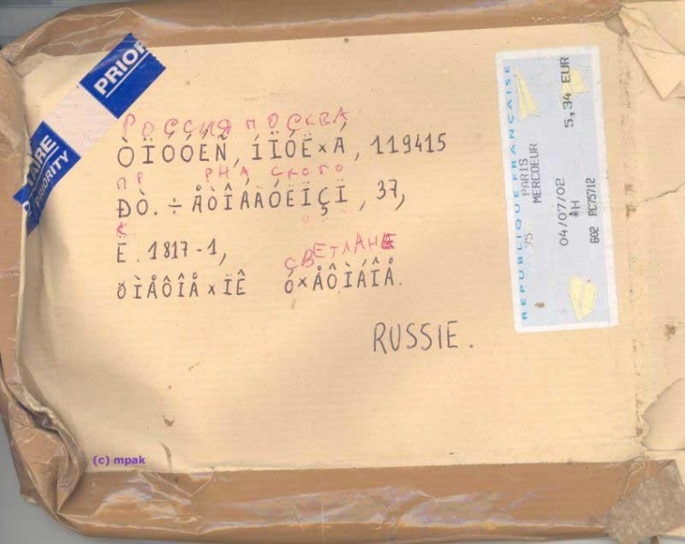
Кракозябры
— Don't
underestimate
the power
of charsets!
— Read chars,
Luke!

Slide 4
UTF8 → CP1251/CP866
val s = "У Лукоморья дуб зелёный"
val utf8Bytes = s.toByteArray(Charsets.UTF_8)
utf8Bytes.toString(charset("CP1251"))
РЈ Р›СѓРєРѕРјРѕСЂСЊСЏ РґСѓР± Р·РµР»С‘РЅС‹Р№
utf8Bytes.toString(charset("CP866"))
╨г ╨Ы╤Г╨║╨╛╨╝╨╛╤А╤М╤П ╨┤╤Г╨▒ ╨╖╨╡╨╗╤С╨╜╤Л╨╣

Slide 5
CP866 → CP1251/UTF8
val s = "У Лукоморья дуб зелёный"
val cp866Bytes =
s.toByteArray(charset("CP866"))
cp866Bytes.toString(charset("CP1251")
“ ‹гЄ®¬®амп ¤гЎ §Ґ«с­л©
cp866Bytes.toString(Charsets.UTF_8)
� �㪮����� �� �����

Slide 6
Reader like Iterator
class ReaderIterator(
private val fileName: String
) : Iterator<Char> {

Slide 7
Reader like Iterator
private val reader: Reader
private var readChar: Int = -1

Slide 8
Reader like Iterator
init {
reader = Files.newBufferedReader(
Paths.get(fileName),
StandardCharsets.UTF_8)
readChar = reader.read()
}

Slide 9
Reader like Iterator
override fun hasNext(): Boolean {
return readChar >= 0
}

Slide 10
Reader like Iterator
override fun next(): Char {
val prevChar = readChar
readChar = reader.read()
return prevChar.toChar()
}

Slide 11
try-with-resources (Java 7)
try (
Reader in = new FileReader("in.file");
Writer out = new FileWriter("out.file")
) {
format(in, out);
}

Slide 12
Catch
} catch (Exception e) {
e.printStackTrace();
}
Don't do this!

Slide 13
Catch
} catch (Exception e) {
logger.error("Format failed", e);
}

Slide 14
Logs
Don't do this!
System.out.println("Hello");
System.err.println("World");
new Exception("stack").printStackTrace();
Hello
World
java.lang.Exception: stack
at it.sevenbits.example.logs.OutPrint.main(OutPrint.java:8)

Slide 15
SLF4J
http://www.slf4j.org/
<dependency>
<groupId>org.slf4j</groupId>
<artifactId>slf4j-api</artifactId>
<version>1.7.25</version>
</dependency>

Slide 16
Simple Logging Facade for Java
import org.slf4j.Logger;
import org.slf4j.LoggerFactory;
public class SLF4JLogSample {
final static Logger logger =
LoggerFactory.getLogger(SLF4JLogSample.class);
public static void main(String[] args) {
logger.info("Hello");
logger.warn("World");
logger.error("error", new Exception("exception"));
}
}

Slide 17
SLF4J
SLF4J: Failed to load class "org.slf4j.impl.StaticLoggerBinder".
SLF4J: Defaulting to no-operation (NOP) logger implementation
SLF4J: See http://www.slf4j.org/codes.html#StaticLoggerBinder for further details.

Slide 18
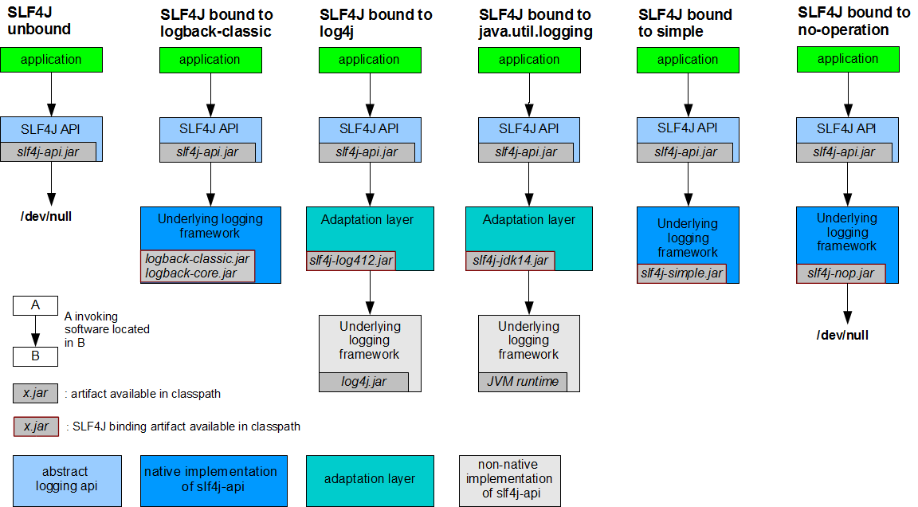

Slide 19
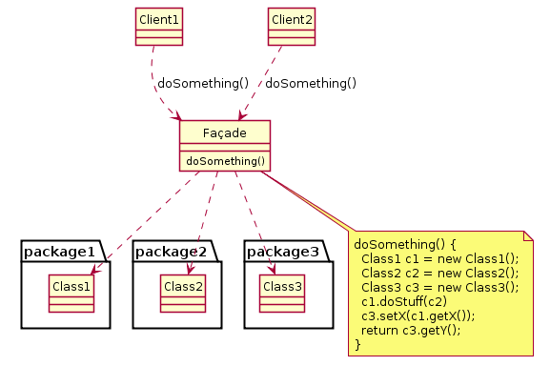

Facade

Slide 20
SLF4J SimpleLogger
<dependency>
<groupId>org.slf4j</groupId>
<artifactId>slf4j-simple</artifactId>
<version>1.7.25</version>
</dependency>

Slide 21
SLF4J SimpleLogger
[main] INFO it.sevenbits.example.logs.SLF4JLogSample - Hello
[main] WARN it.sevenbits.example.logs.SLF4JLogSample - World
[main] ERROR it.sevenbits.example.logs.SLF4JLogSample - error
java.lang.Exception: exception
at it.sevenbits.example.logs.SLF4JLogSample.main(SLF4JLogSample.java:13)

Slide 22
Log Level
logger.trace("tracing (calls)");
logger.debug("debugging (values)");
logger.info("informing (events)");
logger.warn("warning (recoverable errors)");
logger.error("alerting (hard errors)");

Slide 23
Optimizations
String name = "World";
if (logger.isDebugEnabled()) {
logger.debug("Hello, {}!", name);
}

Slide 24
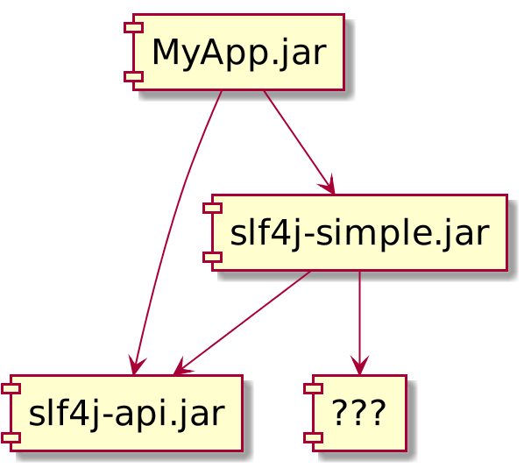
Dependencies

Slide 25
Jar with Dependencies
<plugin>
<groupId>org.apache.maven.plugins</groupId>
<artifactId>maven-assembly-plugin</artifactId>
<version>3.1.0</version>
<configuration>
<descriptorRefs>
<descriptorRef>jar-with-dependencies</descriptorRef>
</descriptorRefs>
<archive>
<manifest>

Slide 26
<configuration>
<descriptorRefs>
<descriptorRef>jar-with-dependencies</descriptorRef>
</descriptorRefs>
<archive><manifest>
<mainClass>it.sevenbits.Main</mainClass>
</manifest></archive>
</configuration>
<executions>
<execution>
<phase>package</phase>
<goals><goal>single</goal></goals>
</execution>
</executions>

Slide 27
Maven Assembly Plugin
Build:
mvn package
Run:
java -jar target/MyApp-1.0-SNAPSHOT-jar-with-dependencies.jar

Slide 28
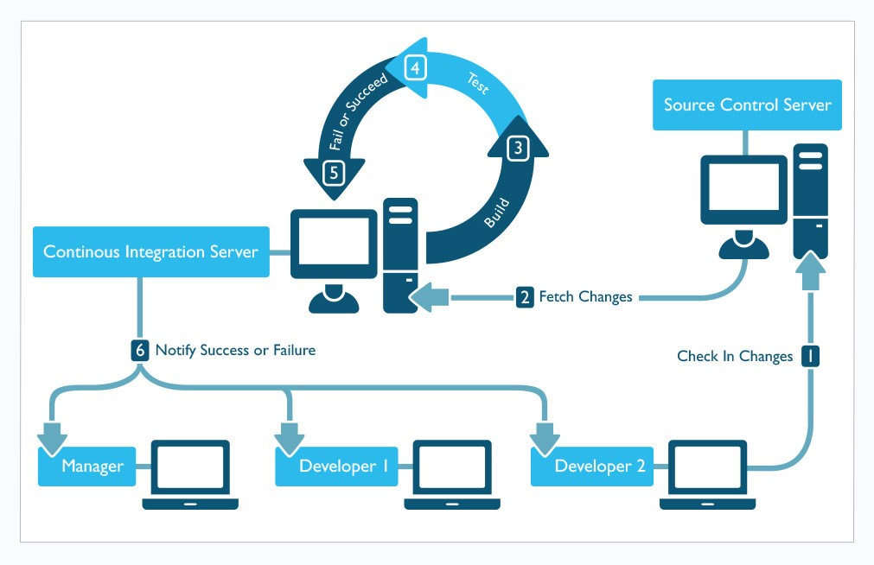
CI

Slide 29
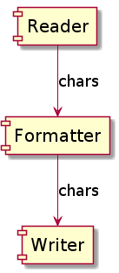
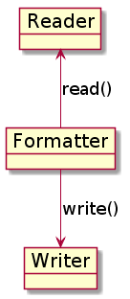
Formatter

Slide 30
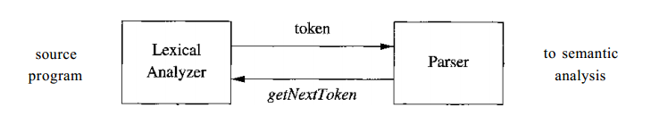
Lexical Analysis

Slide 31
Terms
Lexer, Tokenizer or Scanner — performs
lexical analysis, lexing or tokenization
  converts a sequence of characters into a sequence of tokens
  (strings with an assigned and thus identified meaning)
Lexeme — a sequence of characters
Token — a pair consisting of:
  token name
    separator, whitespace, comment,...
  token value
    lexeme

Slide 32
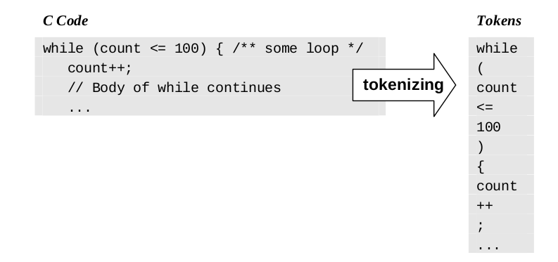
Tokens
Lexeme
Meaning

Slide 33
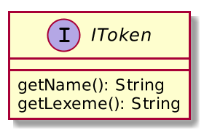
Token

Slide 34
Token Name
Integer
  Explains nothing
Enum
  Not extendable, not SOLID
String
  Self-explained, extendable, can be a key in HashMap
  Spelling problem
    Loose coupling

Slide 35
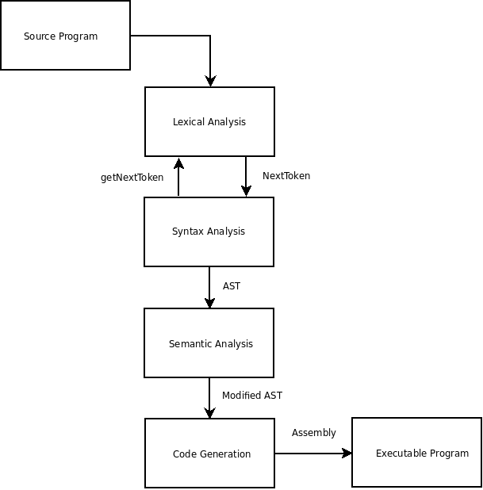
Compiler
https://en.wikipedia.org/wiki/Multi-pass_compiler

Slide 36
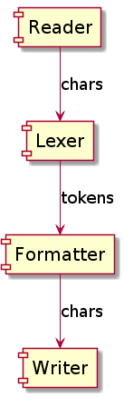
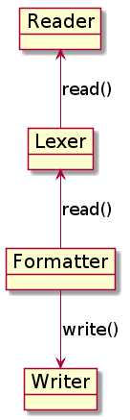
Lexer
+
Formatter

Slide 37
Formatter
public void format(
final ILexer lexer,
final IWriter writer) {
while (lexer.hasMoreTokens()) {
IToken token = lexer.readToken();
String lexeme = token.getLexeme();
// do something
write(writer, lexeme);
}
}

Slide 38
main()
IReader reader = new FileReader(args[0]);
IWriter writer = new FileWriter(args[1]);
ILexer lexer = new Lexer(reader);
IFormatter formatter = new Formatter();
// formatter.format(reader, writer);
formatter.format(lexer, writer);

Slide 39
Lexer
public IToken readToken() {
while (reader.hasMoreChars()) {
char c = reader.readChar();
// append character to current lexeme
// OR
return newToken();
}
return newToken();
}

Slide 40
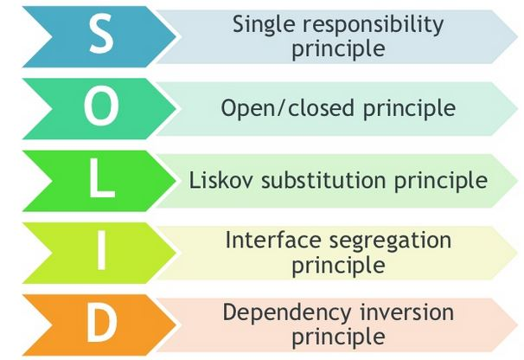
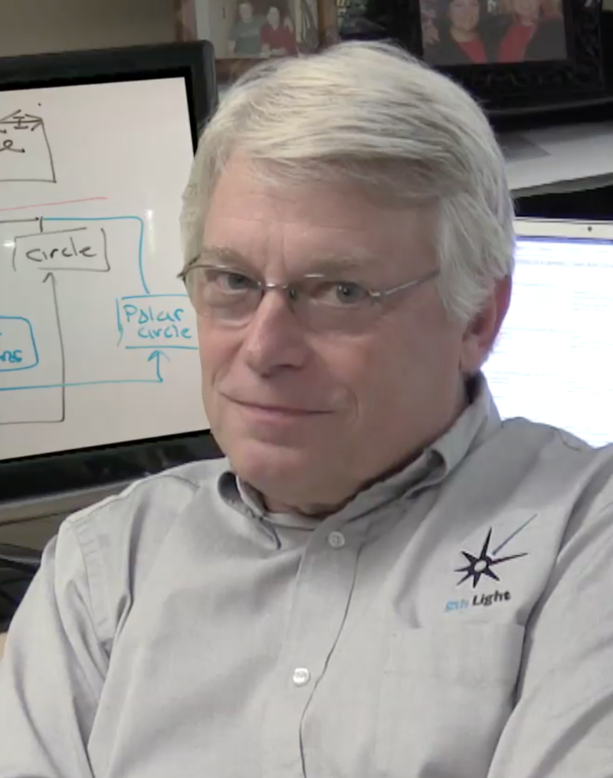
Robert C. Martin "Uncle Bob"

Slide 41
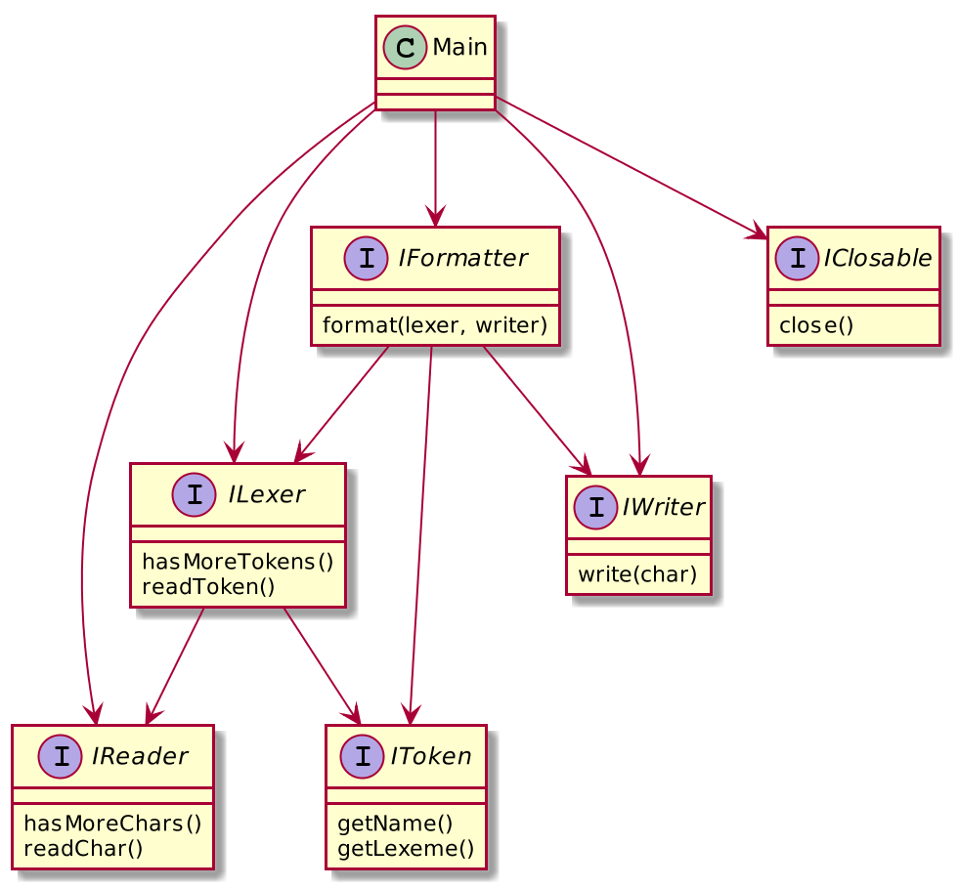
S —
Single
Responsibility

Slide 42
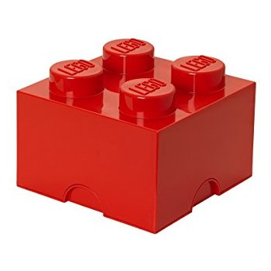
O — Open/Closed
Software entities (classes, modules, functions, etc.)
should be open for extension,
but closed for modification.

Slide 43
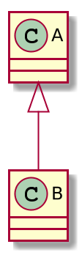
Extends?
class B extends A
A
B
A
B
A∩B
A
B
A
B
A=B
B
A⊇B
A
A⊆B

Slide 44
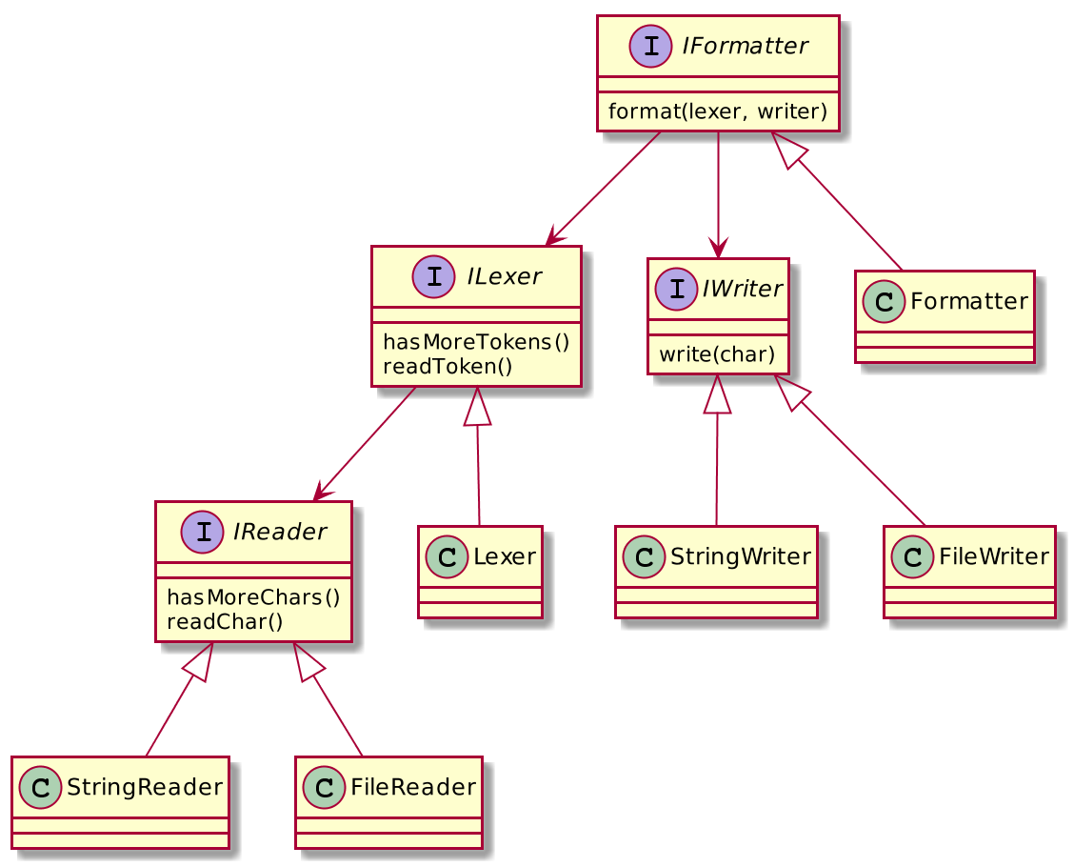

L —
Liskov
Substitution
Barbara Liskov

Slide 45

I —
Interface
Segregation

Slide 46
D — Dependency Inversion
A. High-level modules should not
depend on low-level modules.
Both should depend on abstractions.
B. Abstractions should not depend on details.
Details should depend on abstractions.

Slide 47
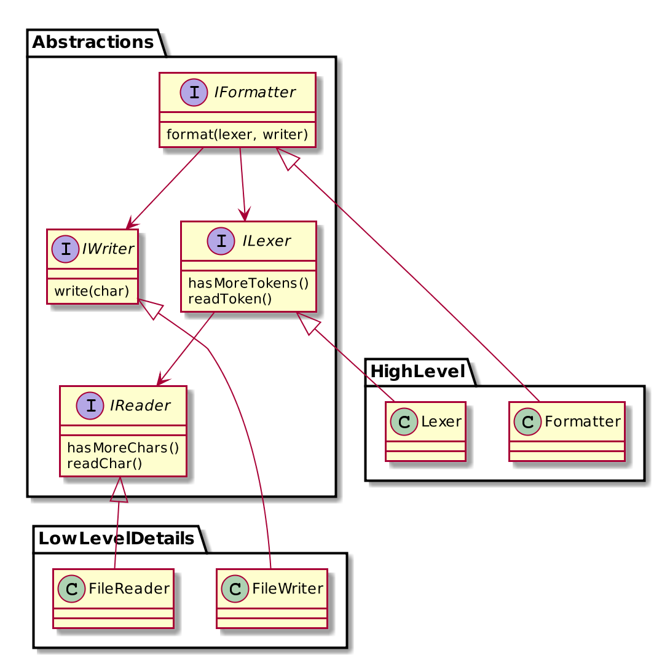
D —
Dependency
Inversion

Slide 48
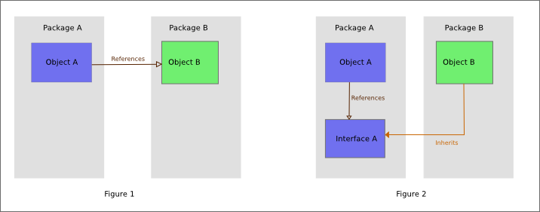
Dependency Inversion

Slide 49
Homework
Complete the Checklist
  https://github.com/7bits/formatter-example
  https://en.wikipedia.org/wiki/SOLID_(object-oriented_design)
Add logging where necessary
Make a Lexer
  Reads the text
  Extracts significant lexemes
  Outputs lexemes
  https://en.wikipedia.org/wiki/Lexical_analysis

Slide 50
Homework
To: back-teachers@7bits.it
Subj: Java Homework #06
Deadline: Sunday 23:59 (midnight)
https://7bits-courses.slack.com/messages/C7R2R4AMB/

